Slide 1

Why learn
1
Open source
2
Large community
3
Contains all you may needed
4
Used on every field
5
Free
6
Gateway to a well paid job

Slide 2
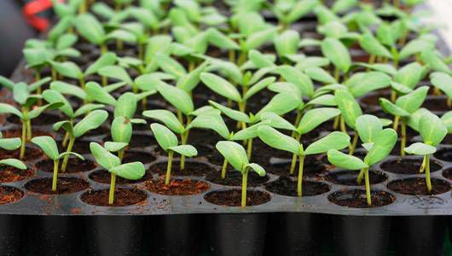
Expensive
High mortality

Slide 3






The Individual
The Sample
The Population

Slide 5

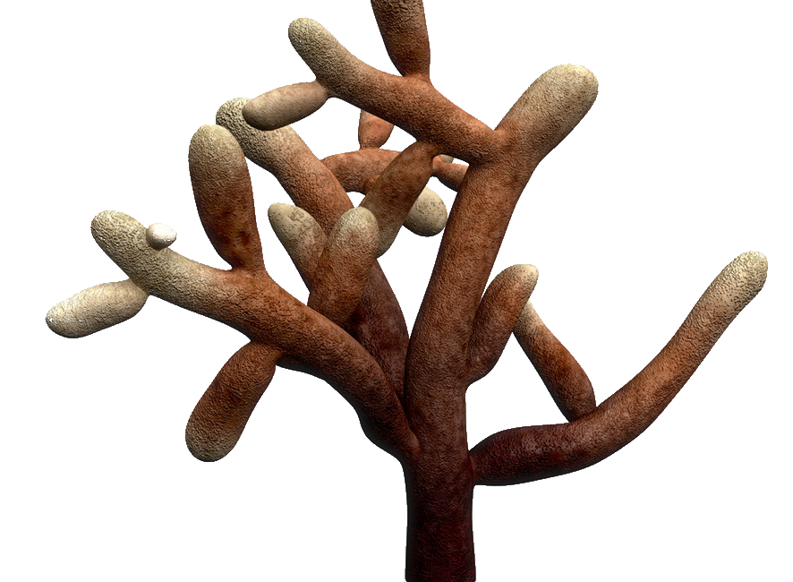
Replicates
0mg
10mg
20mg
Control
Treatments
Independent variable

Slide 6
0mg
10mg
20mg

Slide 7
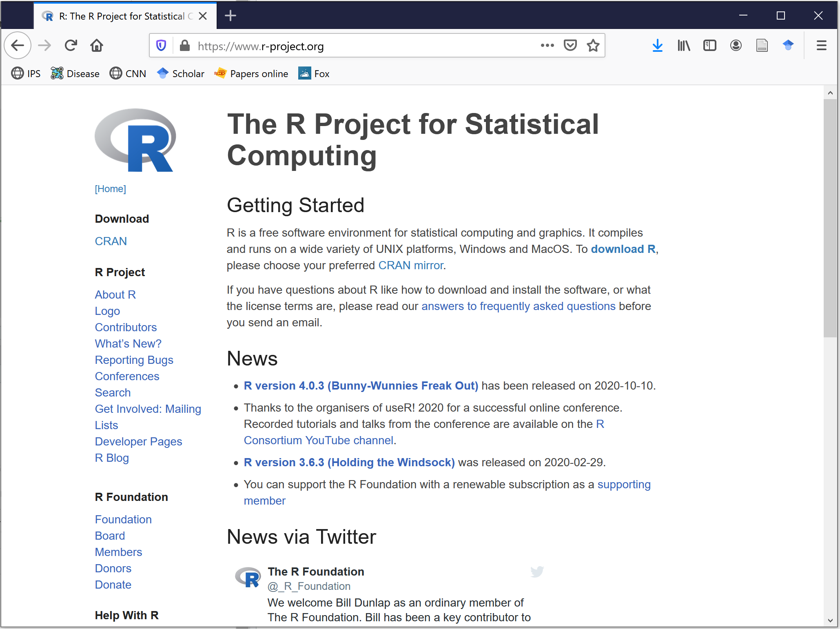

Slide 8
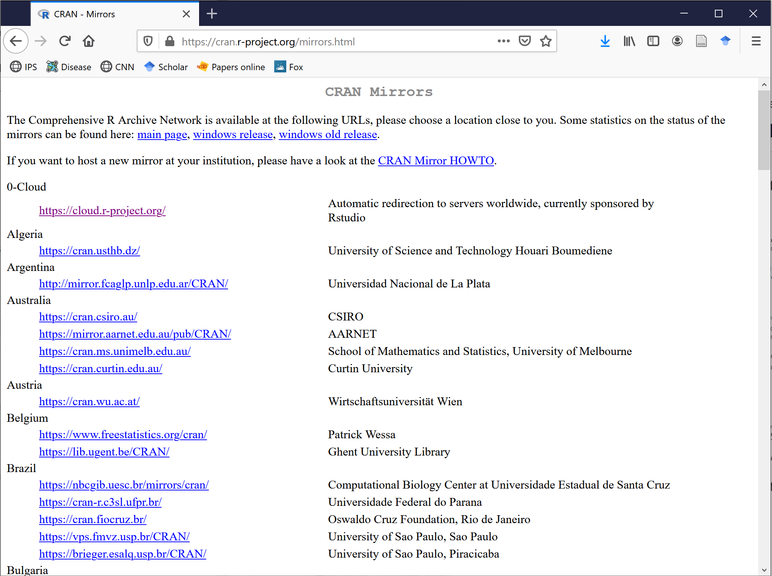

Slide 9
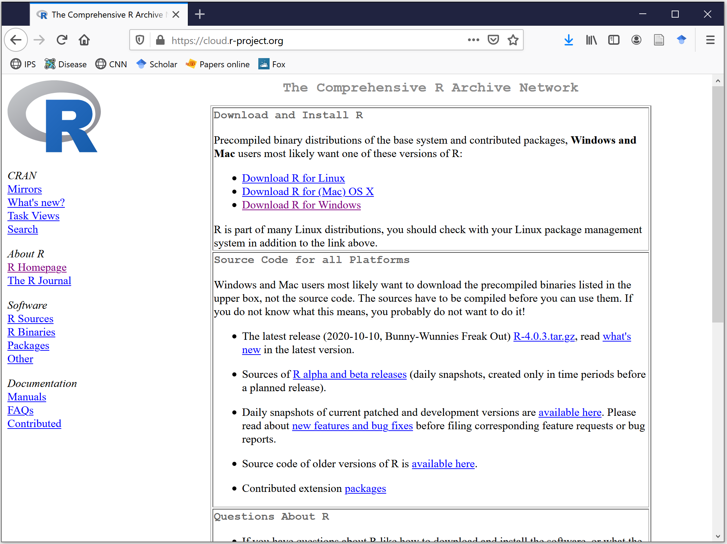

Slide 10
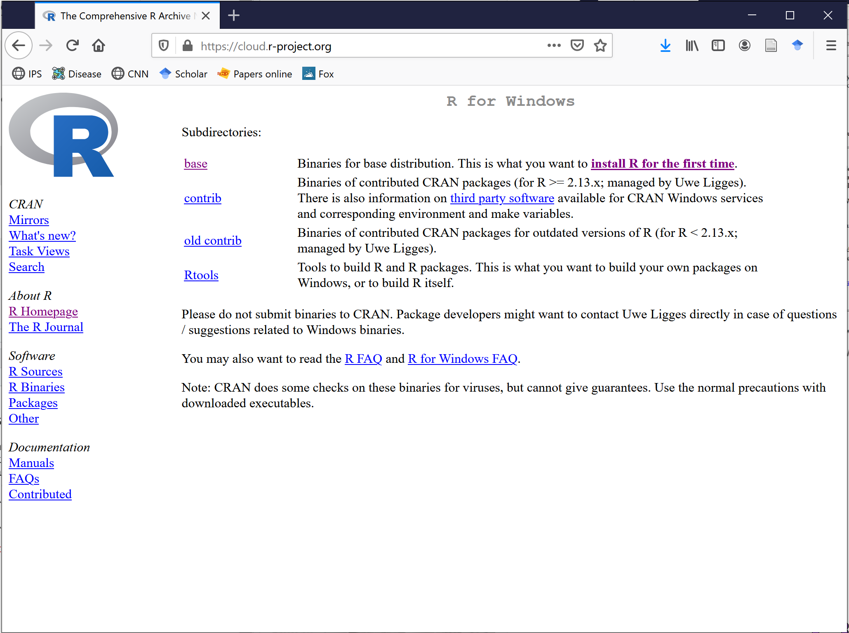

Slide 11
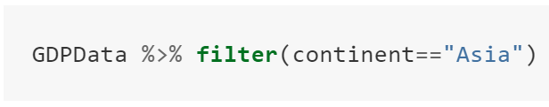
Dataframe
Function
Pipe
Condition

Slide 12
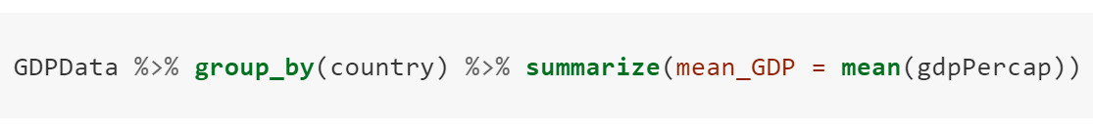
Dataframe
Operation #1
Operation #2
Function to apply
Pipe #1
Pipe #2
Variable name of result
Data to apply function to

Slide 13
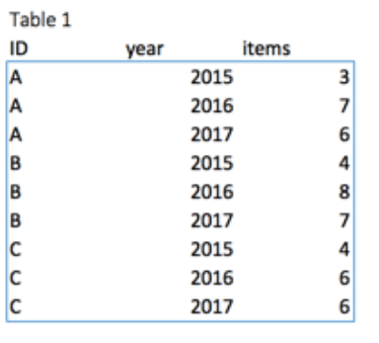
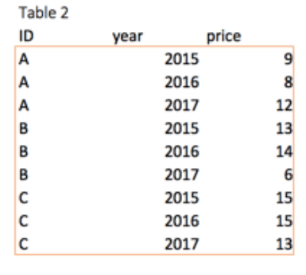
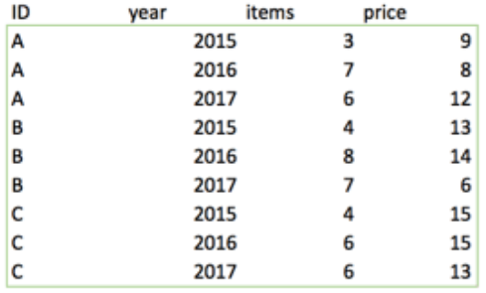
+

Slide 14
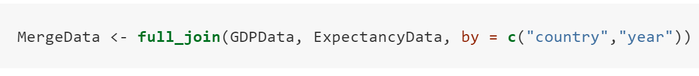
Name for results
Common columns to merge by
Function
Database 1
Database 2
Merge by

Slide 15
Measures of central tendency
Median
Mean
Mode
Trimmed mean
Geometric mean
Harmonic mean
Weighted mean

Slide 16











10% 20% 30% 40% 50% 60% 70% 80% 90 %
45cm
10% 20% 30% 40% 50% 60% 70% 80% 90 %

Slide 17
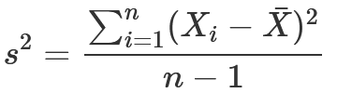
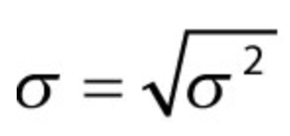
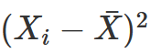
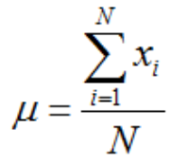
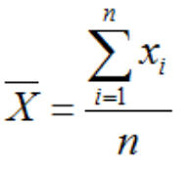
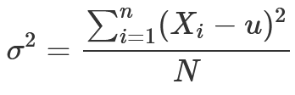
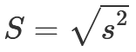


Slide 18
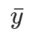

Y
Y
High y
Low x
Y
High y
High y
High y
*
Low x
High x
*
High x
*
*
*
*
*
*
*
*
*
*
*
*
*
*
*
*
*
*
*
*
*
*
*
*
*
*
Low y
*
*
*
*
Low y
Low x
*
High x
Low y
Low y
X
X
Low x
High x
X
Low y
Low x

Slide 19
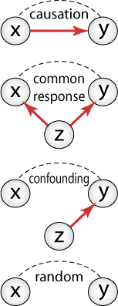

Slide 20

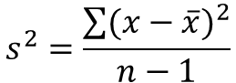
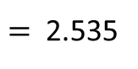
The Variance
The variance measures how far a set of numbers is spread out from their average value
$$s^{2}=\frac{\sum{{(x−\overline{x})}^{2}}}{n−1}$$
$$= \frac{{(−2.1)}^{2}+{(−0.8)}^{2}+{(−0.2)}^{2}+{(1.2)}^{2}+{(1.9)}^{2}}{5−1}$$
$=$ 2.535
ss
1.9
Hours a week of study
Peter
Laura
John
Chip
Tom
1.2
0.5
1.8
2.4
3.8
4.5
-0.8
-0.2
‾x=2.6
-2.1
Peter
Laura
John
Chip
Tom
Hours a week of study
0 1 2 3 4 5

Slide 21



The CoVariance
The covariance is a “precursor” to calculate the strength of the relationship between two variables
The CoVariance
The Variance
$$s^{2}=\frac{\sum{(\text{x}\text{−}\overline{x})∗(y−\overline{y}) }}{n−1}$$
$$=\frac{\left(−2.1\right)\left(−19.2\right)+\left(−0.8\right)\left(−10.2\right)+\left(−0.2\right)\left(0.8\right)+\left(1.2\right)\left(7.8\right)+(1.9)(20.8)}{5−1}$$
$$s^{2}=\frac{\sum{{(x−\overline{x})}^{2}}}{n−1}$$
Test
Score
(%)
100
+1.9
Tom
Name | Hours a week of study | Final score
Peter | 0.5 | 55
Laura | 1.8 | 64
John | 2.4 | 75
Chip | 3.8 | 82
Tom | 4.5 | 95
+20.8
90
Chip
-0.2
↓
80
+1.2
+0.8→
+7.8
John
‾y=74.2
70
-10.2
Laura
-0.8
60
-19.2
Peter
-2.1
50
1 2 3 4 5
Peter
Laura
John
Chip
Tom
‾x=2.6
Hours a week of study

Slide 22
…Let’s understand what the COVARIANCE is doing?…
100
‾x=2.6
+
Tom
90
Chip
Test
Score
(%)
80
John
‾y=74.2
70
+
Laura
60
Peter
50
Peter Laura John Chip Tom
1 2 3 4 5
Hours a week of study

Slide 23
…Let’s understand what the COVARIANCE is doing?…
100
-
-
+
90
Test
Score
(%)
80
70
-
60
-
+
50
1 2 3 4 5
Hours a week in Facebook

Slide 24
…the idea with COVARIANCE is that is can allow to classify relationships that are…
100
100
100
Negative
Positive
No relationship
90
90
90
80
80
80
70
70
70
60
60
60
50
1 2 3 4 5
50
1 2 3 4 5
50
1 2 3 4 5

Slide 26
100
Tom
90
Chip
Test
Score
(%)
80
John
…students that studied long scored high in their tests…
70
…the relationship between time studying and the test scores can be summarized with this line…
Laura
60
…students that studied briefly scored low in their tests…
Peter
50
Peter Laura John Chip Tom
1 2 3 4 5
Hours a week of study

Slide 27
100
Tom
90
…this relationship has a positive slope…
…basically, when you study long….
Chip
…you score high in the test….
Test
Score
(%)
80
…AND….
John
…when you study briefly….
…you score low….
70
Laura
60
Peter
50
Peter Laura John Chip Tom
1 2 3 4 5
Hours a week of study

Slide 28
100
90
…this relationship has a negative slope…
…basically, when you spend a lot of time in Facebook….
…you score low in the test….
Test
Score
(%)
80
…AND….
…when you use Facebook briefly….
…you score high….
70
60
50
1 2 3 4 5
Hours a week in Facebook

Slide 29
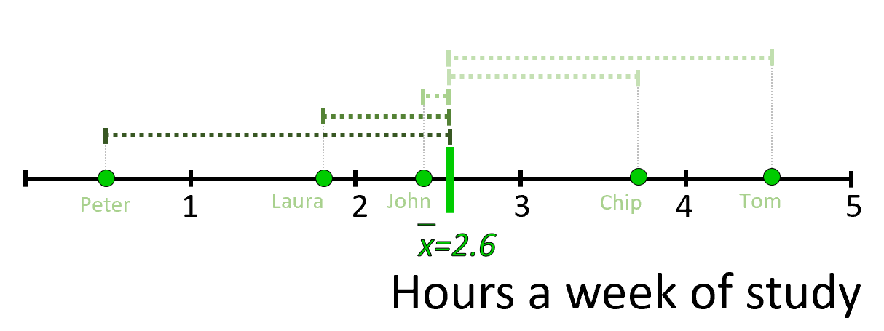
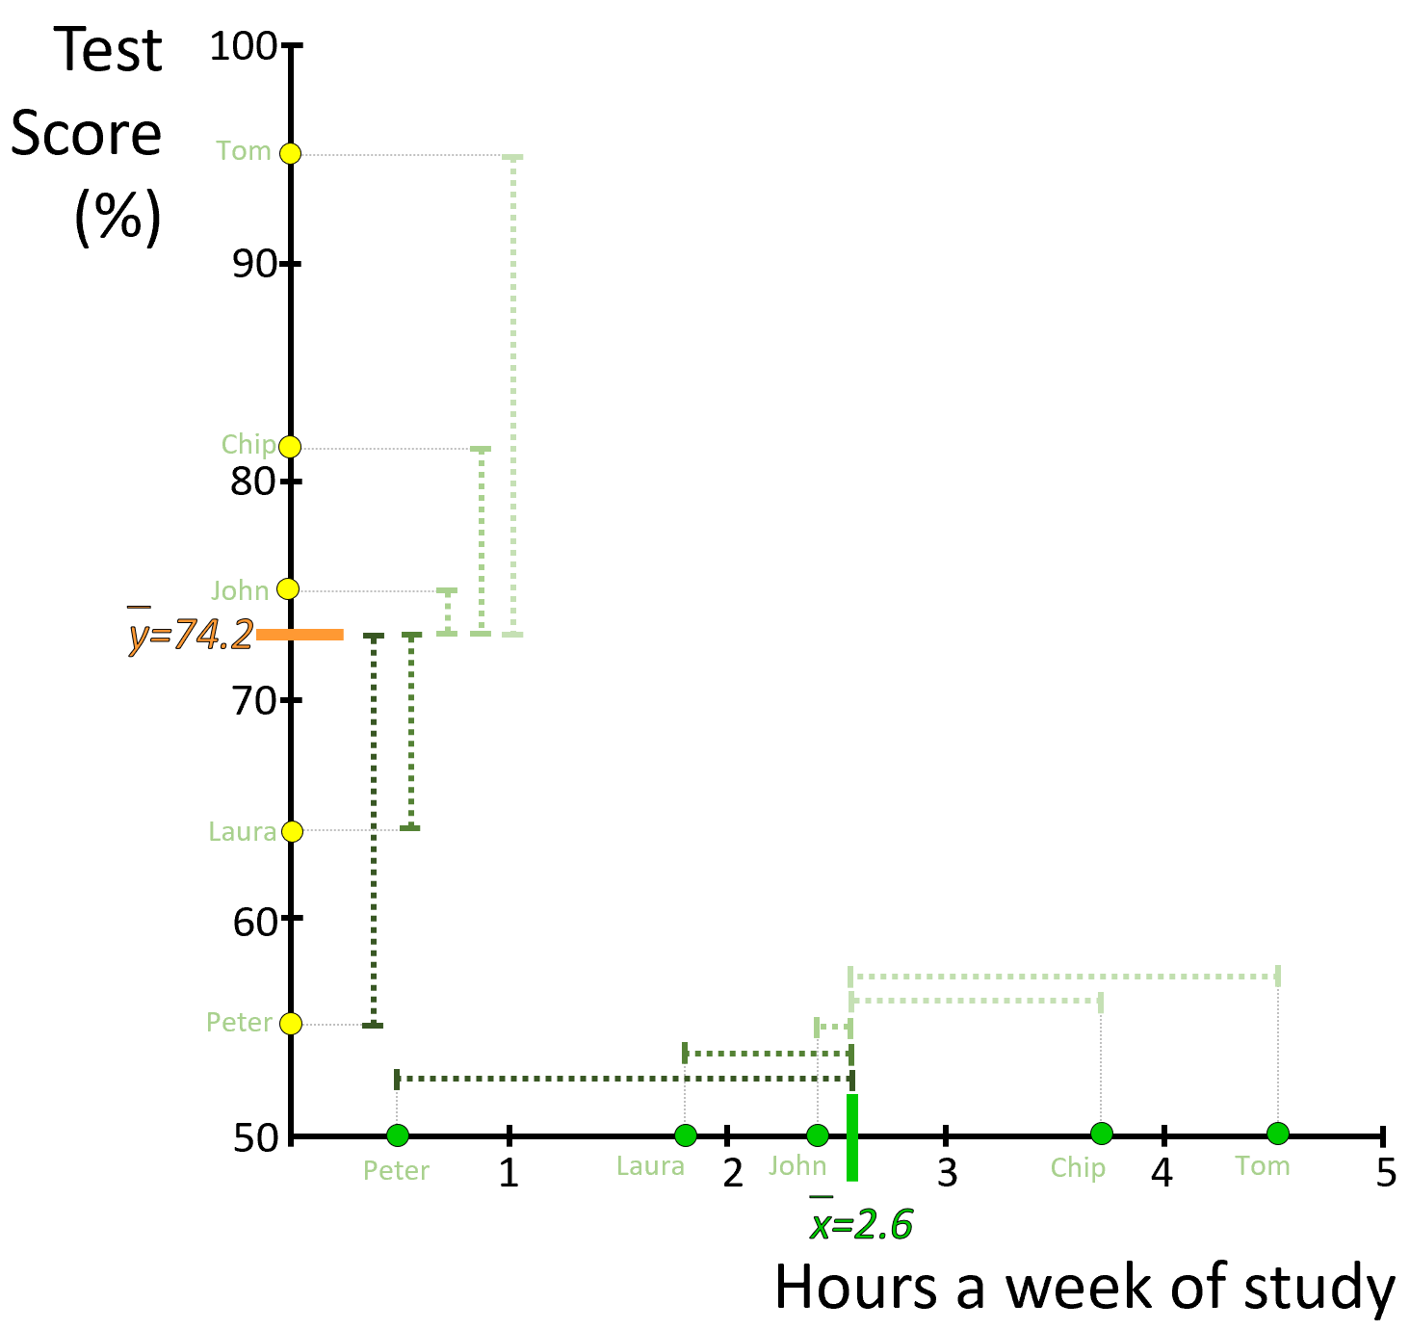
1.2
1.9
-0.8
-0.2
-2.1
20.8
7.8
0.8
-10.2
-19.2
1.2
1.9
-2.1
-0.8
-0.2

Slide 30
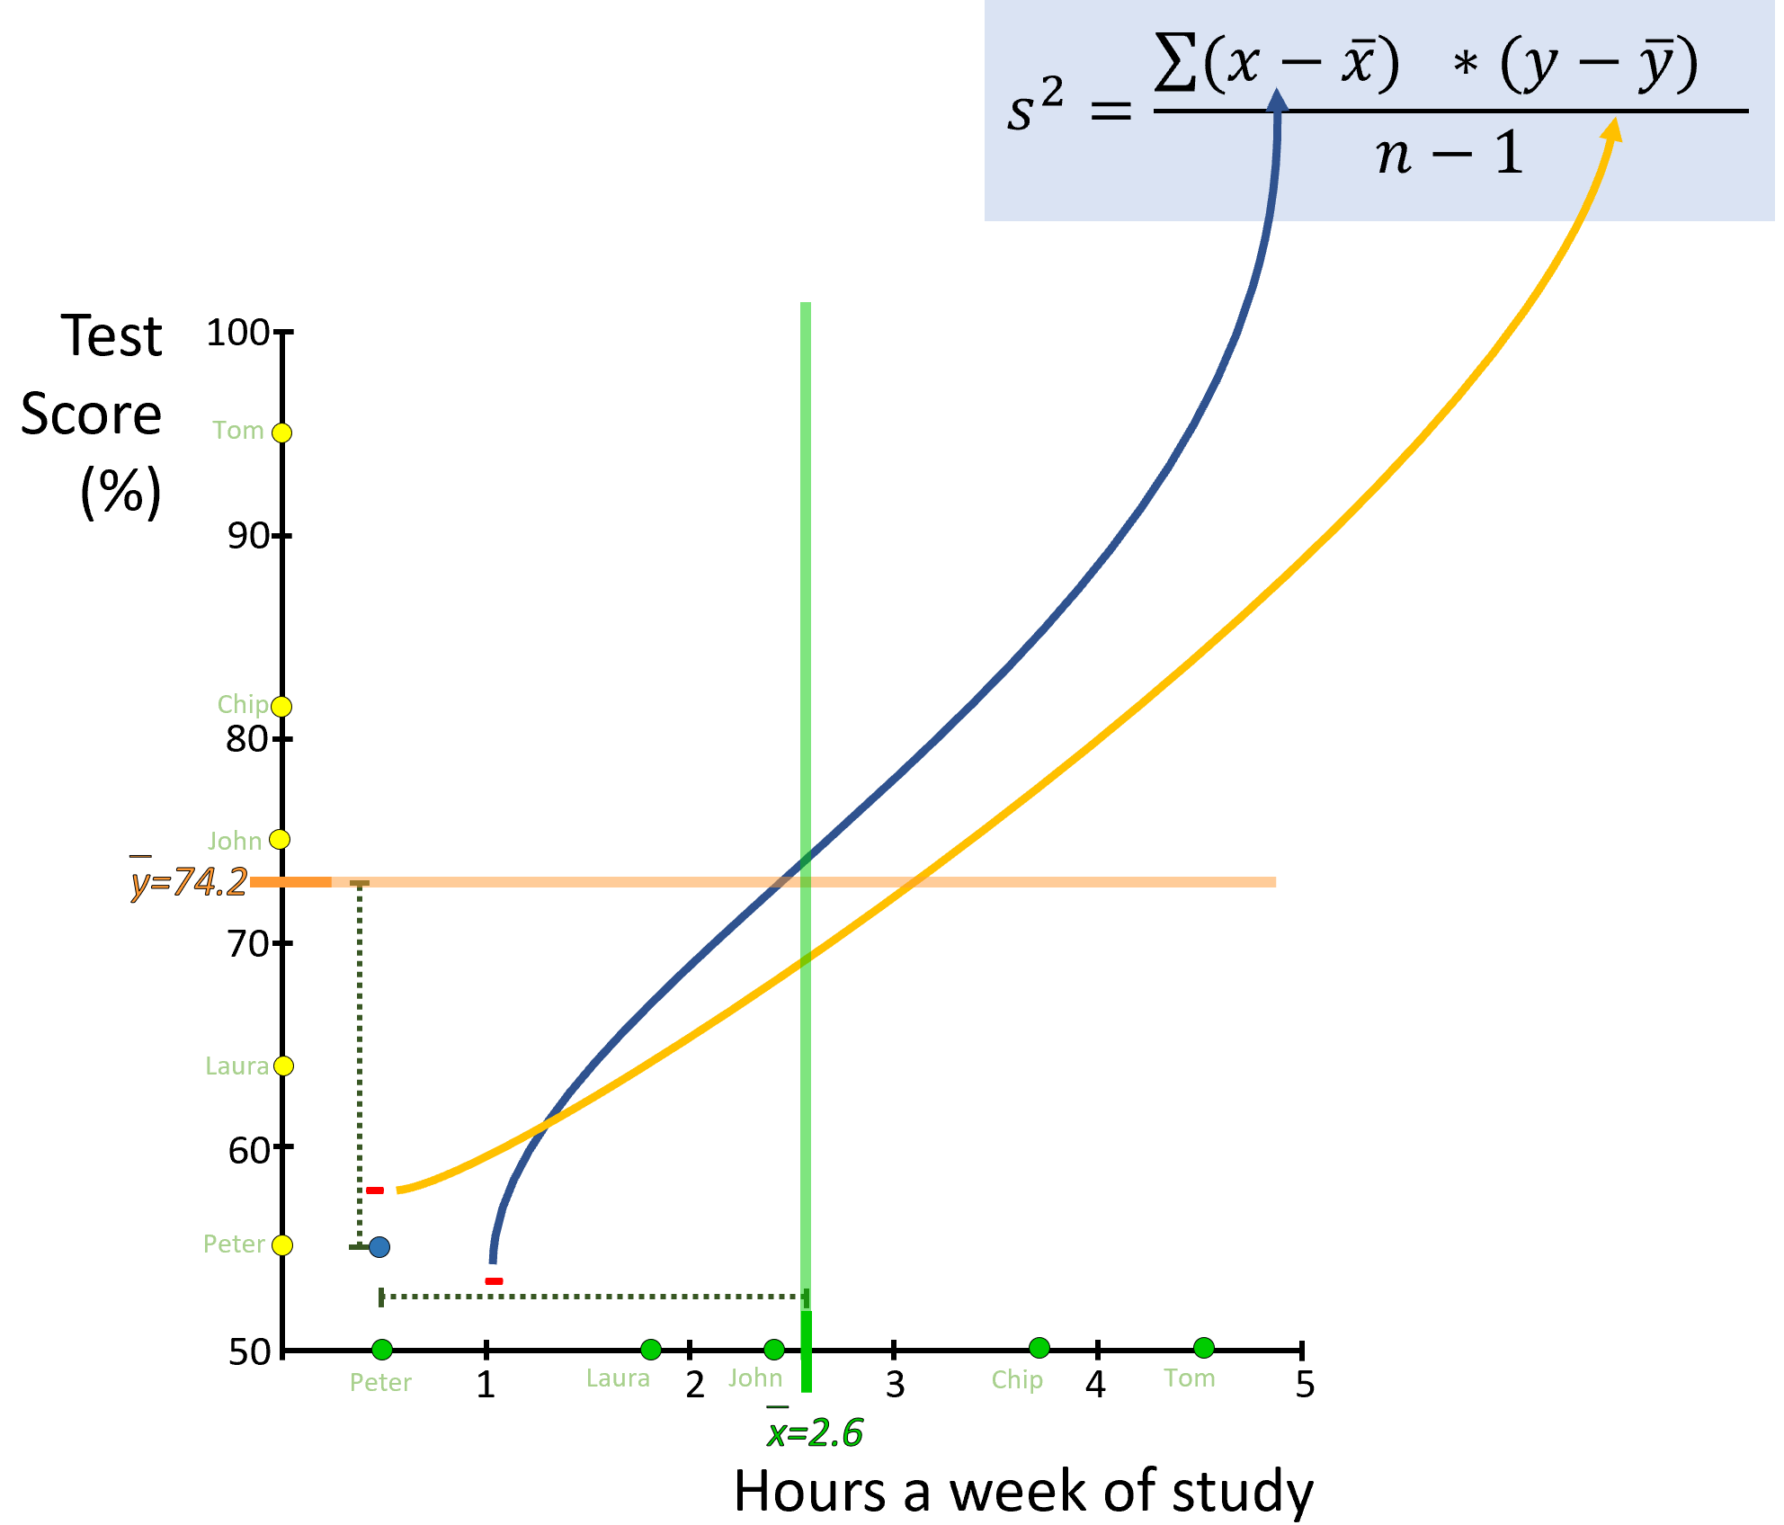
-19.2
-2.1

Slide 31
100
100
100
90
90
90
80
80
80
70
70
70
60
60
60
50
1 2 3 4 5
50
1 2 3 4 5
50
1 2 3 4 5

Slide 32
100
100
90
90
80
80
70
70
60
60
50
50
1 2 3 4 5
1 2 3 4 5

Slide 33
100
100
90
90
80
80
70
70
60
60
50
1 2 3 4 5
50
1 2 3 4 5

Slide 34
Test
Score
(%)
100
?
?
Tom
90
Chip
80
John
70
?
?
Laura
60
Peter
50
Peter Laura John Chip Tom
1 2 3 4 5
Hours a week of study

Slide 35
Y
100
90
80
←The Slope→
70
*
←
60
The intercept
50
1 2 3 4 5
X

Slide 36
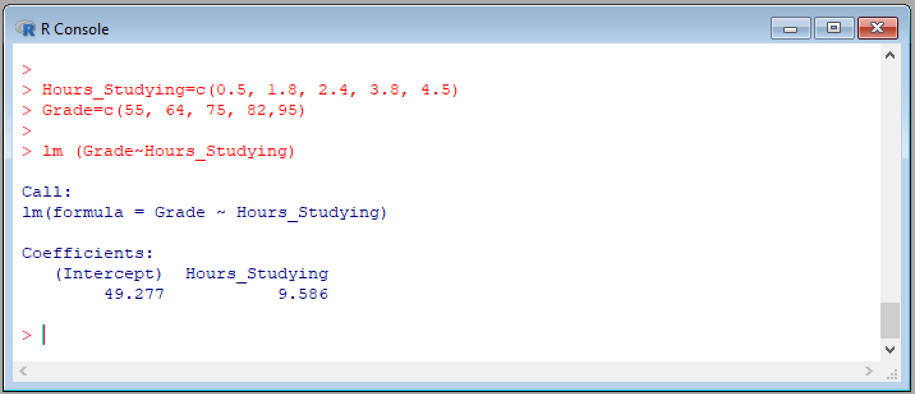
The model
Intercept
Slope

Slide 37
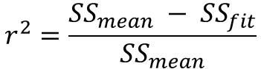
The coefficient of determination, r²
Test
Score
(%)
Test
Score
(%)
100
100
Sum of Squares around the Fit, SS_{fit}
Tom
Tom
90
90
Chip
Residuals
Chip
$$r^{2}=\frac{{SS}_{mean} − {SS}_{fit}}{{SS}_{mean}}$$
80
80
John
John
‾y=74.2
70
70
Laura
Laura
Sum of Squares around the Mean, SS_{mean}
60
60
Peter
Peter
50
50
1 2 3 4 5
Peter
Laura
John
Chip
Tom
Hours a week of study

Slide 38
100
90
80
70
60
50
1 2 3 4 5

Slide 39
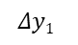
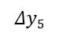

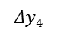
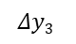
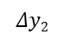
Test
Score
(%)
Sum of Squares around the Mean
SS_{mean}
100
Tom
90
$$Δy5$$
Chip
80
$$Δy4$$
John
$$Δy3$$
‾y=74.2
70
$$Δy2$$
Laura
60
$$Δy1$$
Peter
50
${{SS}_{mean}=(Δy1)}^{2}$+${(Δy2)}^{2}$ + ${(Δy3)}^{2}$ + ${(Δy4)}^{2}$ + ${(Δy5)}^{2}$

Slide 40
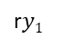
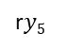

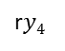

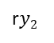
Test
Score
(%)
Sum of Squares around the Fit
SS_{fit}
100
Tom
r$y5$
90
Chip
r$y4$
80
John
$$ry3$$
70
r$y2$
Residuals
Laura
60
Peter
r$y1$
${{SS}_{fit}=(ry1)}^{2}$+${(ry2)}^{2}$ + ${(ry3)}^{2}$ + ${(ry4)}^{2}$ + ${(ry5)}^{2}$
50
1 2 3 4 5
Peter
Laura
John
Chip
Tom
Hours a week of study

Slide 41
Extrapolation
Interpolation
Extrapolation
100
90
Test
Score
(%)
80
70
60
50
1 2 3 4 5
Hours a week of study

Slide 42
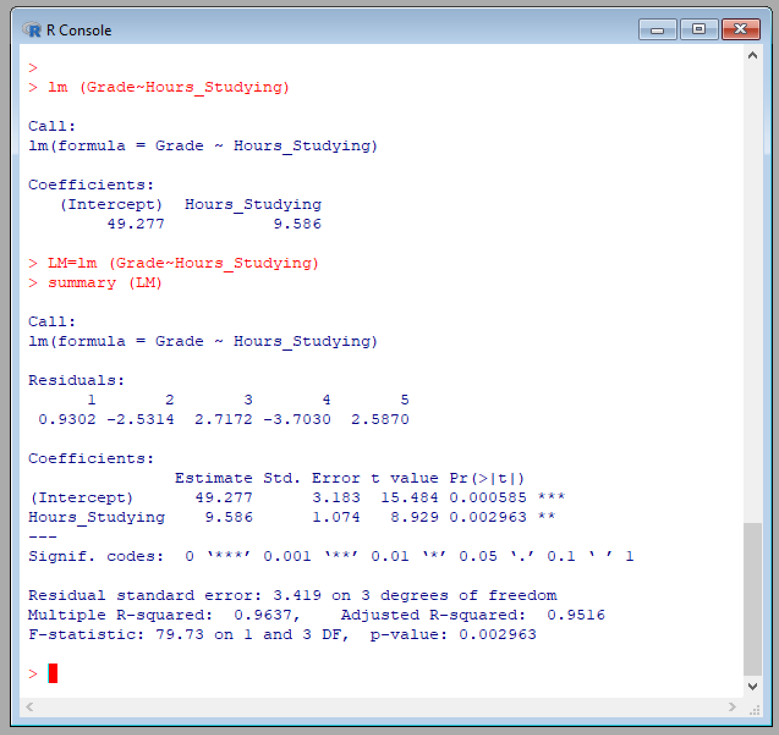
F-value
P-value

Slide 43
The model
Intercept
Slope
F-value
r²
P-value

Slide 46
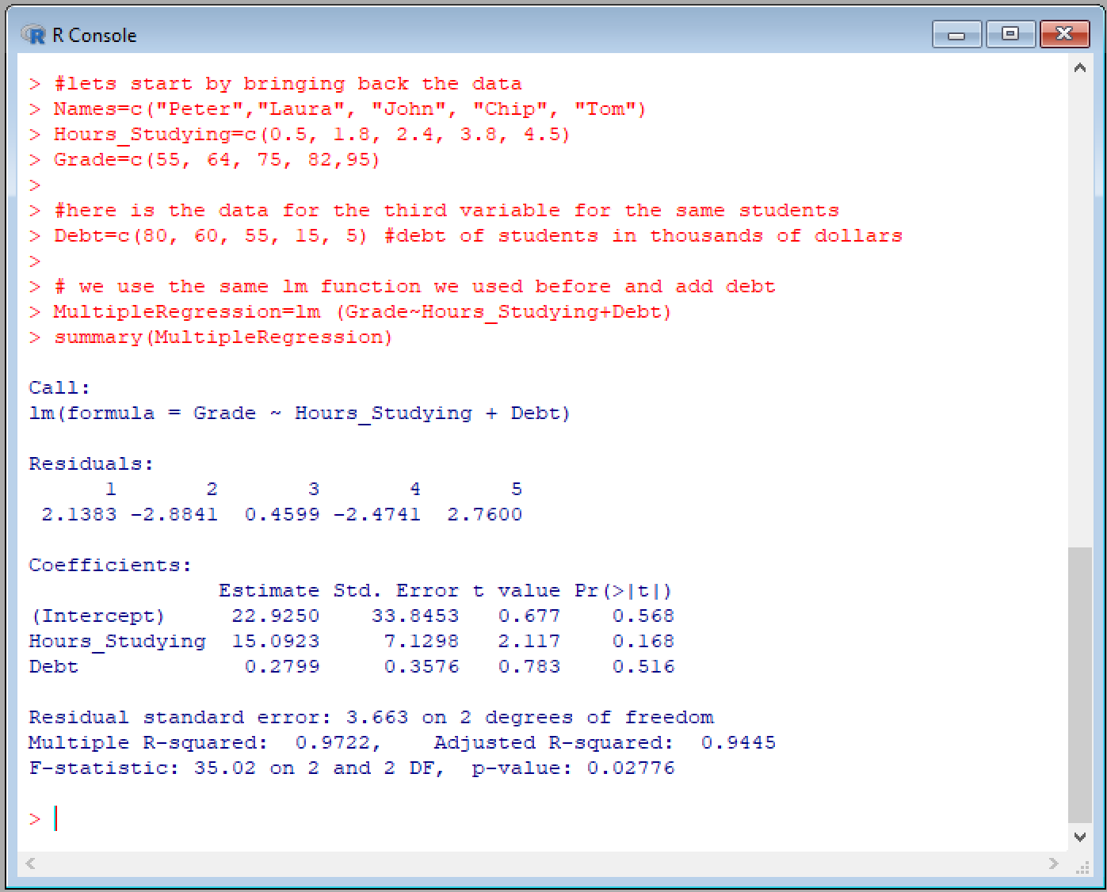
Multiple regression
Intercept
Slopes
P-values for Individual variables
P-values for full model

Slide 47












?
6.8
8.8
Size
1
1.5
3.5
3.6
4
4.5
5.1
5.6
6.1
7

Slide 48


Hell←→Heaven
Type II error
(so-call false negative)
I did things thinking they were good but ended up being bad. This error could send me to hell
No error here
I did all things I know were good
I ended up in heaven doing everything right
Good
↑
↓
Bad
←God’s divine judgement
Type I error
(so-call false positive)
I did not do things thinking there were bad but were actually good.
I ended up in heaven but it cost me enjoying life
No error here
I did all things I know were bad
I ended up in hell but I was confident of it
↑
Human judgement (α)

Slide 49
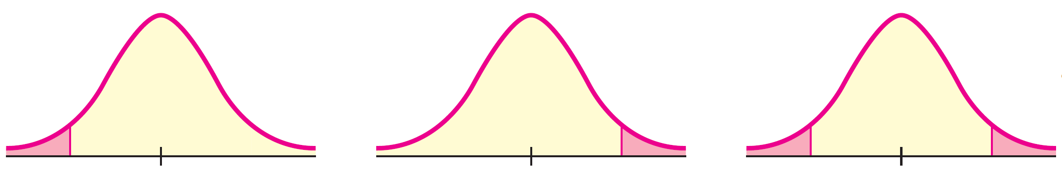
H_{o}: u >= k
H₁: u < k
Left-sided test
H_{o}: u <= k
H₁: u > k
Right-sided test
H_{o}: u = k
H₁: u ≠ k
Two-tail test
Reject
Reject
Reject
Reject
α
α
α/2
α/2

